Slide 1


Pulling Open Jobs/Orders Report in CRM

Slide 2
Running Open Jobs/Orders Report in CRM
In CRM, click in the header on “Reports”
Click on “Select a Report”
In the “Jobs, Orders, Quotes, Job Quotes” section, pick
  “Job/Order Status Details” Report
To Select your Department, Click “Filter Options in top left
for Memphis Motor Repair,
  Click Memphis as branch, then motor Repair as department
Click “Run”
If you want to download into excel, click “Filter Options” again
Click “download”
An excel output will appear in the bottom taskbar

Slide 3
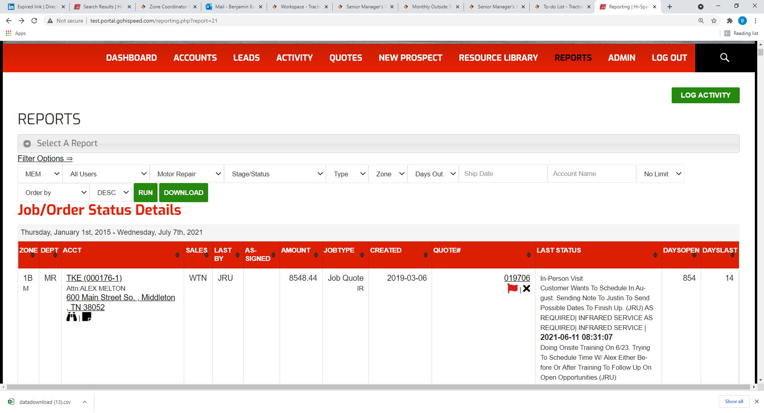
Example

