Slide 1
Entering Forecast in CRM

Slide 2
Entering Forecast in CRM
In CRM, click in the header on “Reports”
Click on “Select a Report”
In the “Financial” section, pick
“Monthly Forecast” Report
We forecast twice a month.
Pick your department by looking at the column and the row
Row indicates the branch.
Click on the Pencil Icon
A separate page will pop up.
Confirm your Branch and Department are Correct.
Enter Revenue to Date, Revenue to Be Billed by Month End.
Scroll Down and Enter Revenue Projected for the Following Month.
Click Save
Confirm results are correct by going back to Financial Section and Picking “Monthly Forecast” Report

Slide 3
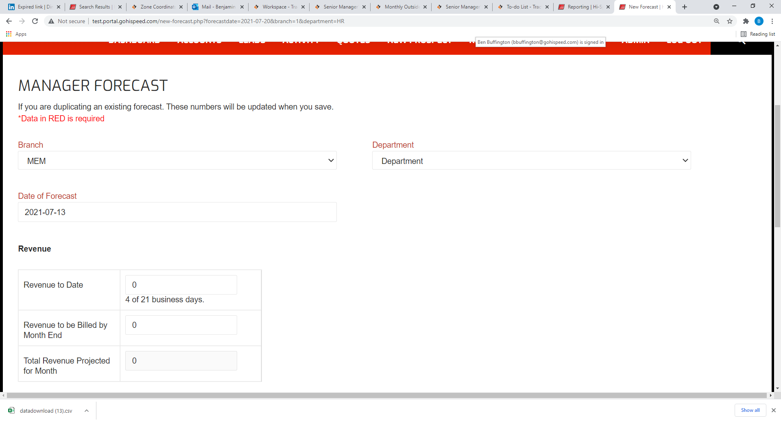
Example

