Slide 1
Inspectall Change Order Requests

Slide 2
Why a change order?
All jobs are quoted for “Free and Clear Access”
Customer is not ready, items in the way of work area (steel, machines, etc)
Install “Using Existing Wiring”
Festoon is damaged, needs to be replaced to complete project
Immediate issues related to job scope
Case by case basis- Wrong materials supplied due to Customer request
Selling truck inventory items
Items not quoted, but Technician upsells items from truck inventory (pendant, drive, contactors, etc)
Estimate/Quoted job not complete
Will need more parts/labor to complete the job

Slide 3
Why NOT a change order?
Job is T&M
Service call, customer to decide if they want the repair quoted or not
Quote is sufficient
No extra charges should apply. Work completed as planned
Customer wants repairs ASAP
Customer wants repairs made as soon as possible. May need to source parts locally or from warehouse
Customer must provide PO before buying any materials. Communicate with Coordinator prior to proceeding on repairs

Slide 4
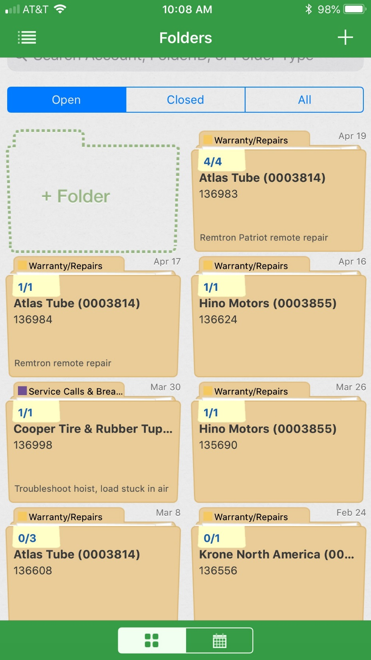
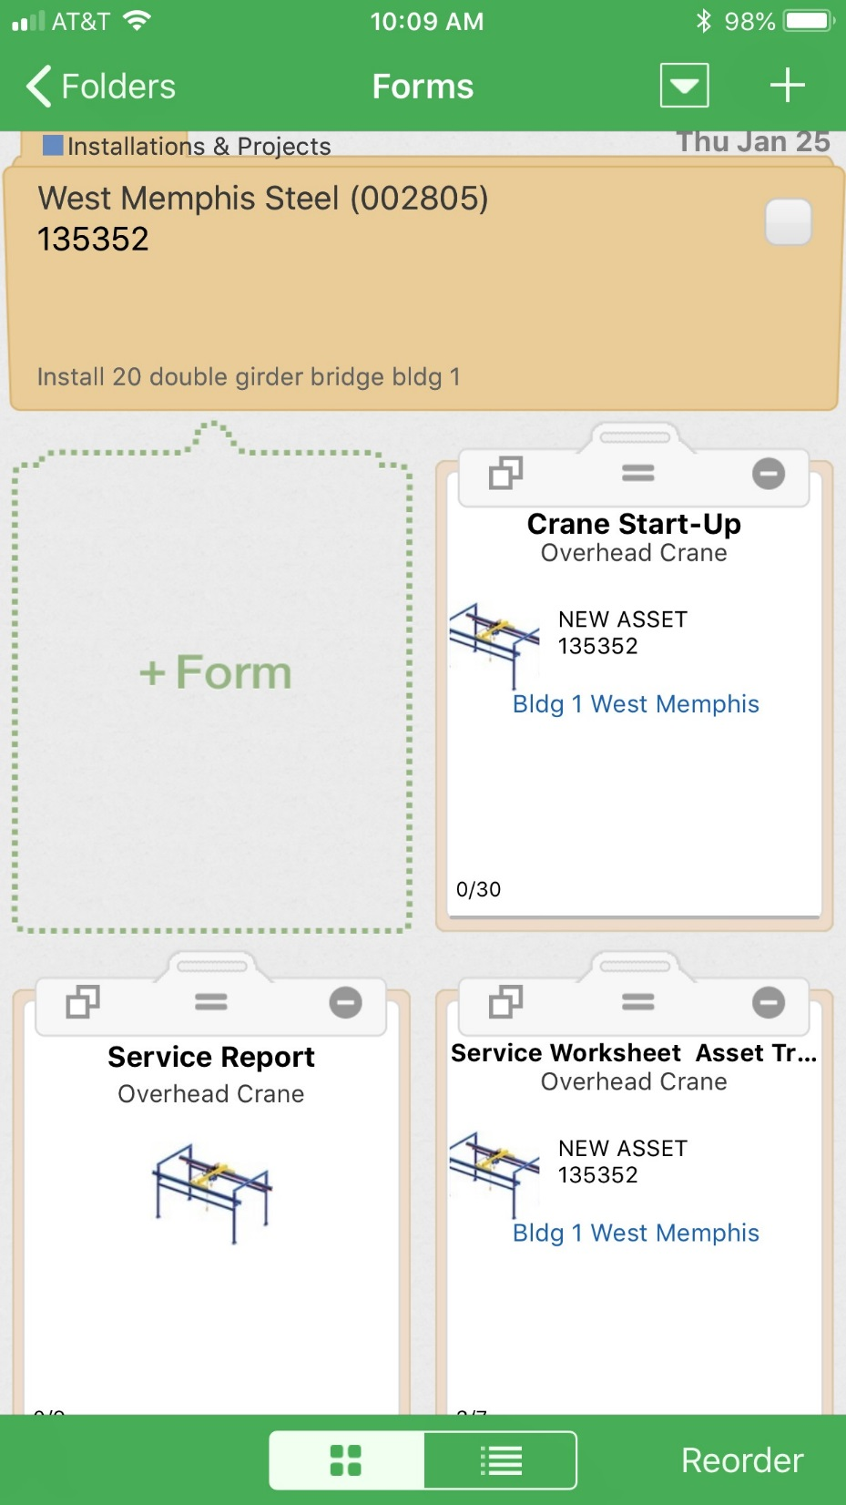
Select current job folder from Inspectall
Select +Form to add form to job
folder
Service Report form has Change Order
Request

Slide 5
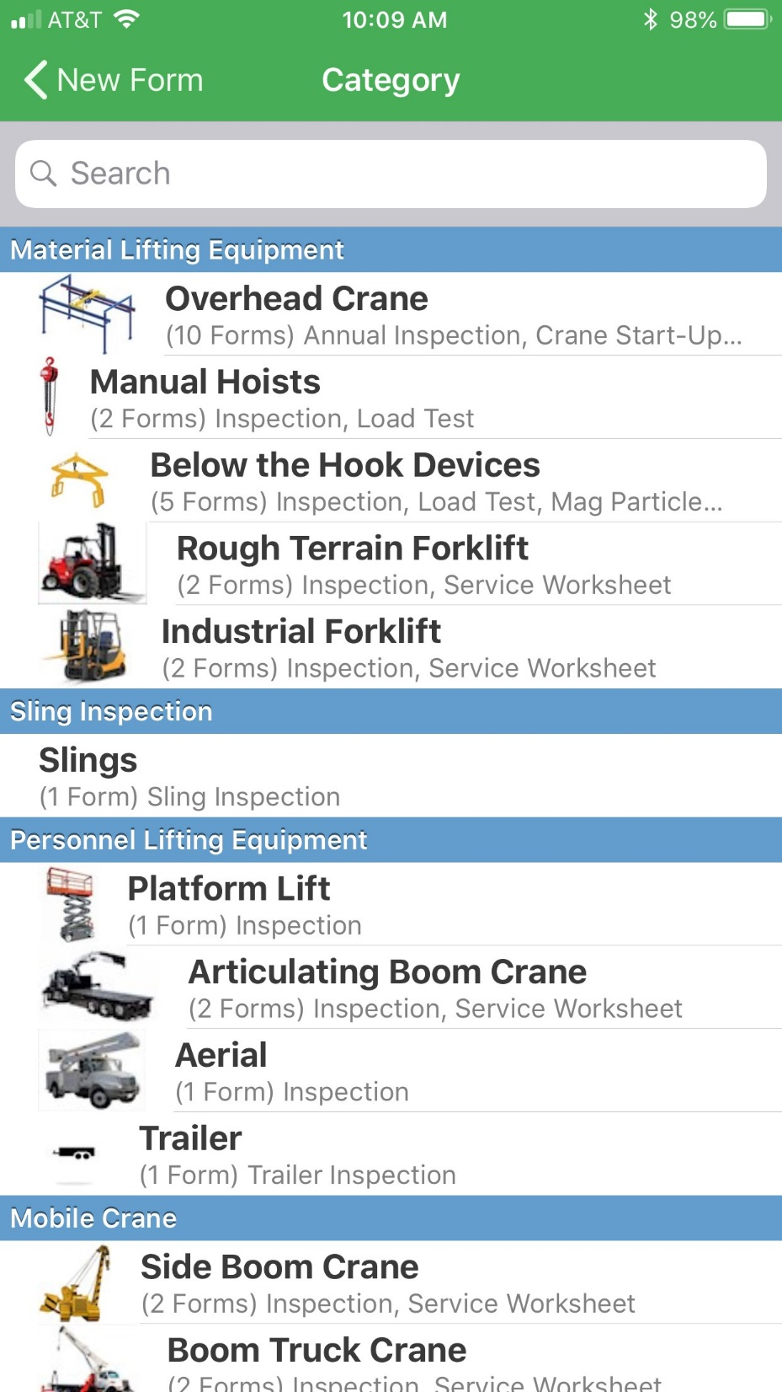
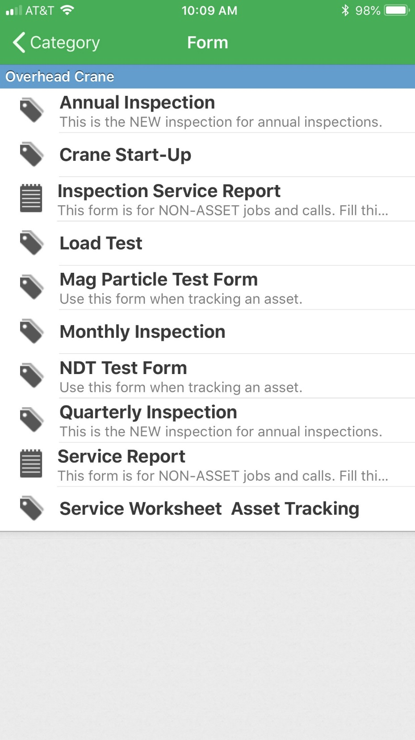
3) Select Overhead Crane category
4) Select Service Report – Change Order included in Service Report

Slide 6
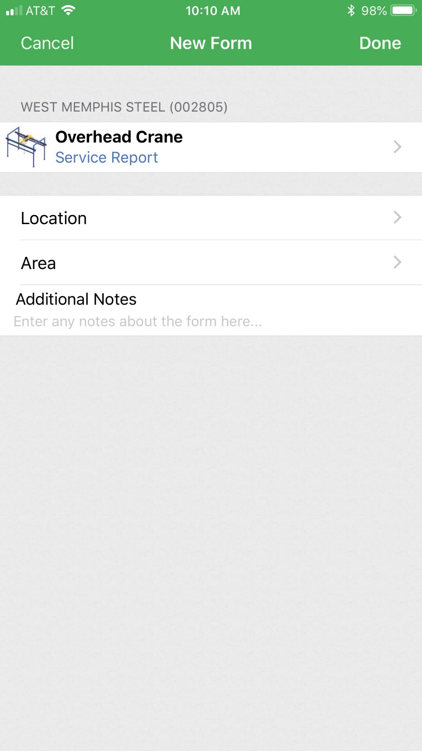
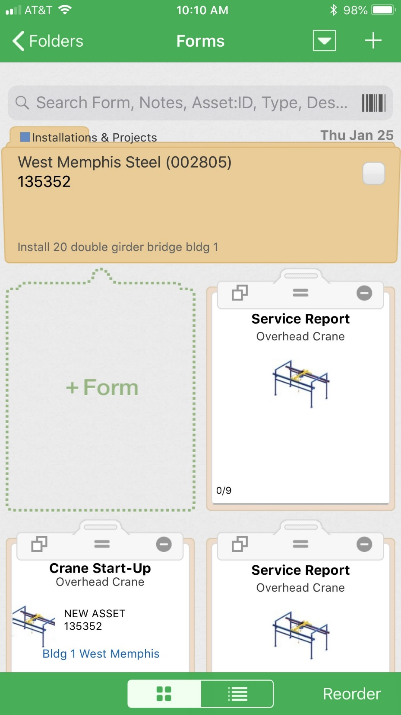
5) Select done. This will bring you to the main job screen again
6) Open Service Report and begin to fill
out job objectives, notes, etc

Slide 7
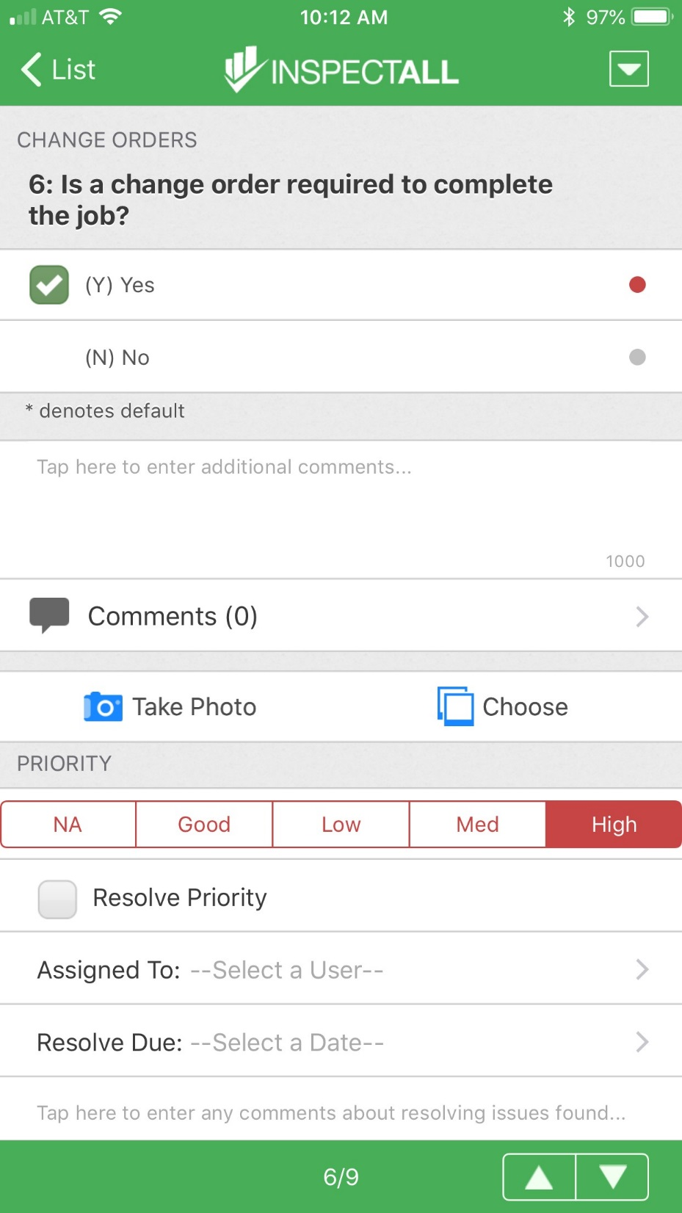
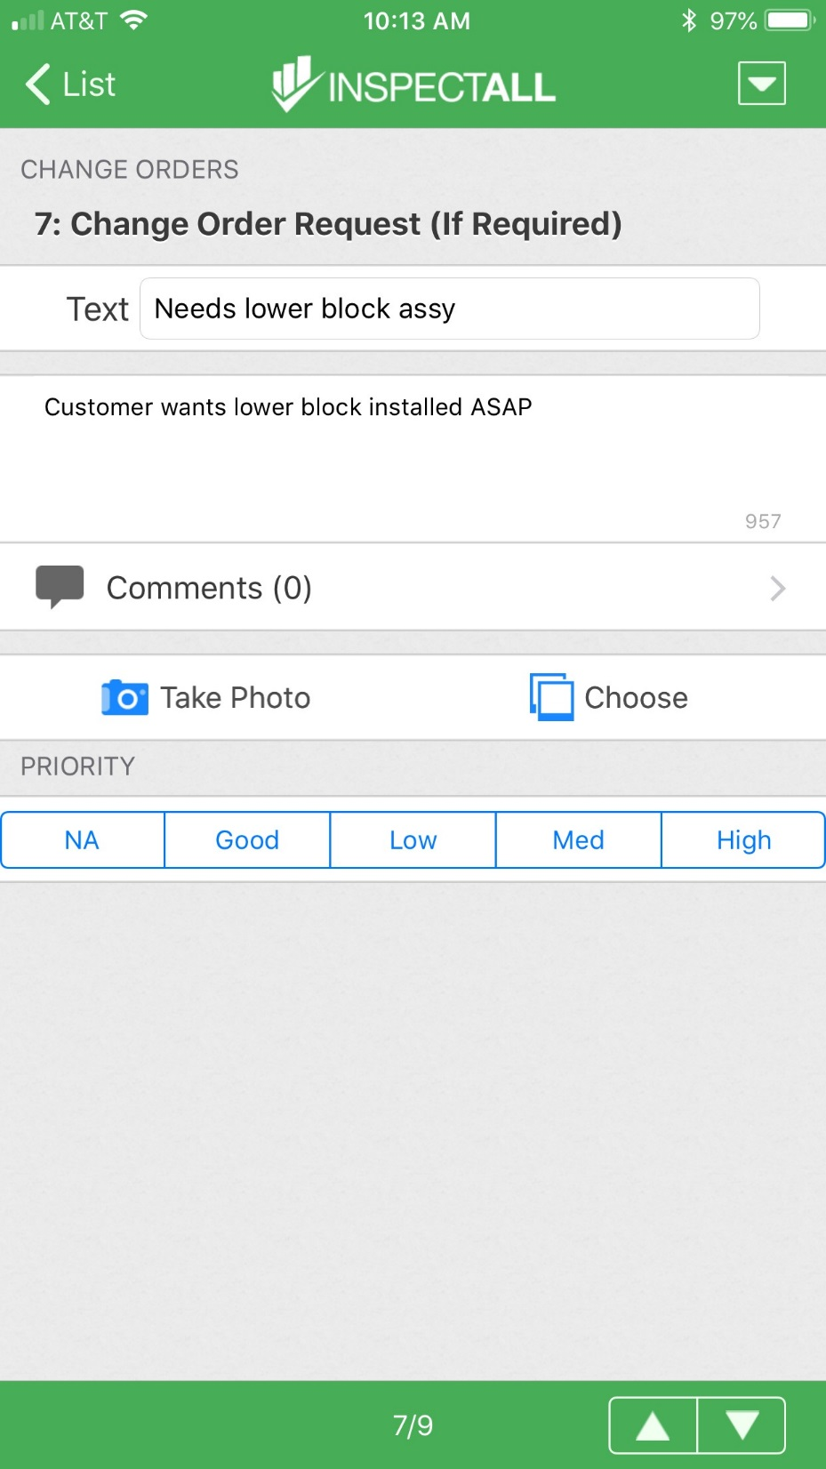
7) Select YES when a change order is needed for the job. ***
Customer needs to determine if new charges will be applied to original job or open a new job
8) Explain the change order request in notes and to the customer. Give as much detail as possible- Delayed start, incorrect equipment/materials supplied by customer.
***A change order is required for any materials/labor not included in the scope of work***

Slide 8
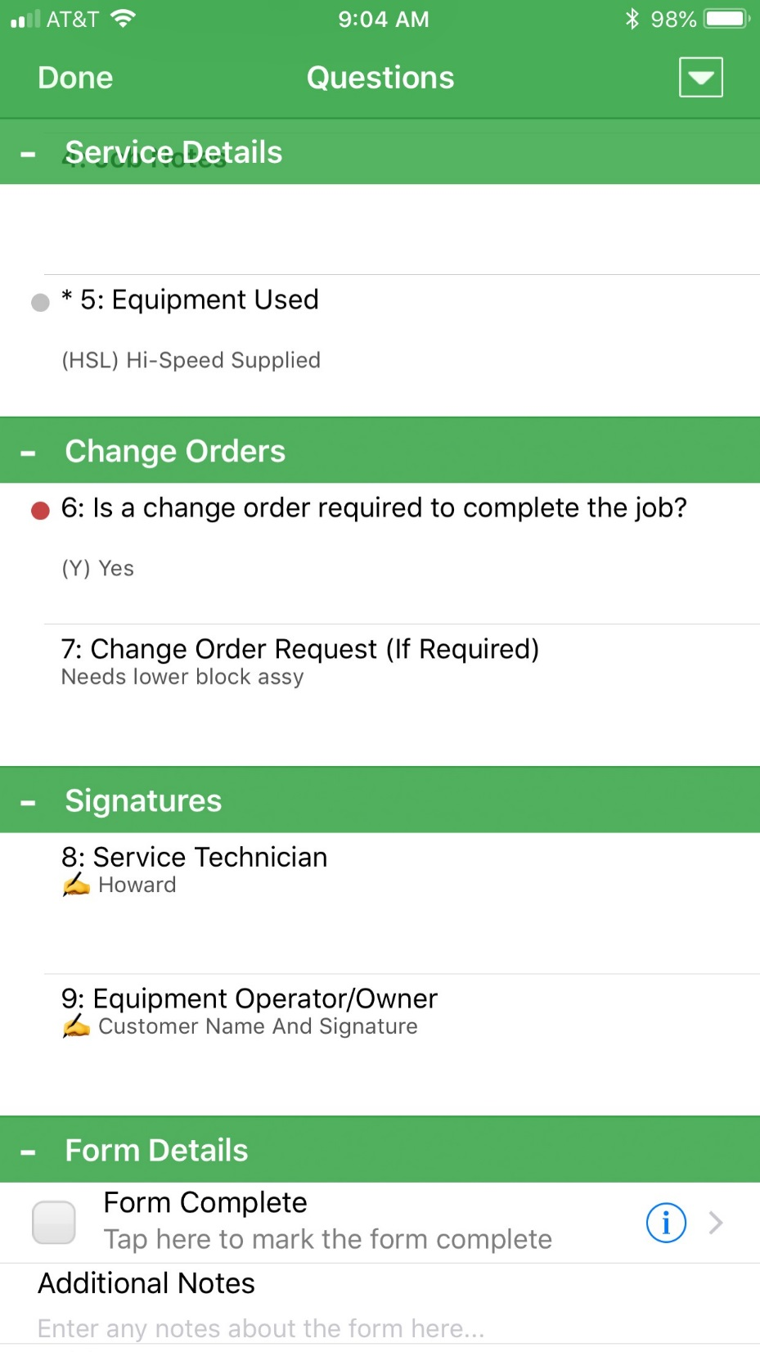
The Change Order is for items (labor, materials) outside the job scope of work
You must have a discussion with the Customer to help them understand the Change Order. If you have questions about the job, call the office
The customer is required to sign the Service Report
Once the assigned tasks are completed, the entire job folder must be downloaded and sent to the Customer- Copy the office personnel

Slide 9
Questions?

